Slide 1
ELECTRON
The Future Brought to the present
Group-I : Zaid Al Taher – Managing Director
Faisal Mostawe – Hardware Engineering
Usman Mehboob – Marketing, Finance, and Sales Manager
Tushar Agarwal – Technical Design and Innovation

Slide 2


Introduction
Internet of Things – Car Parking and Traffic Management.
Our aim is to build a system prototype for a project that will help improve electric car charging and traffic management.
Minimal Electrical Power usage and Maximum Functionality design.
Stuck in Traffic?
Can’t Find a parking spot?
Need to recharge your electric car?

Slide 3
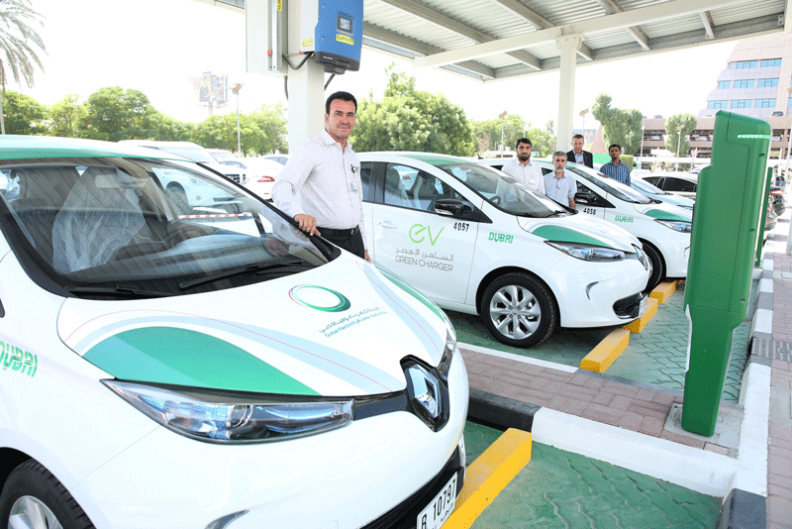
Electron’s Proposal One
Proposal One: Electric Car Parking Monitor.
Informs you which charging stations are available.
Informs you when your vehicle is done charging.

Slide 4
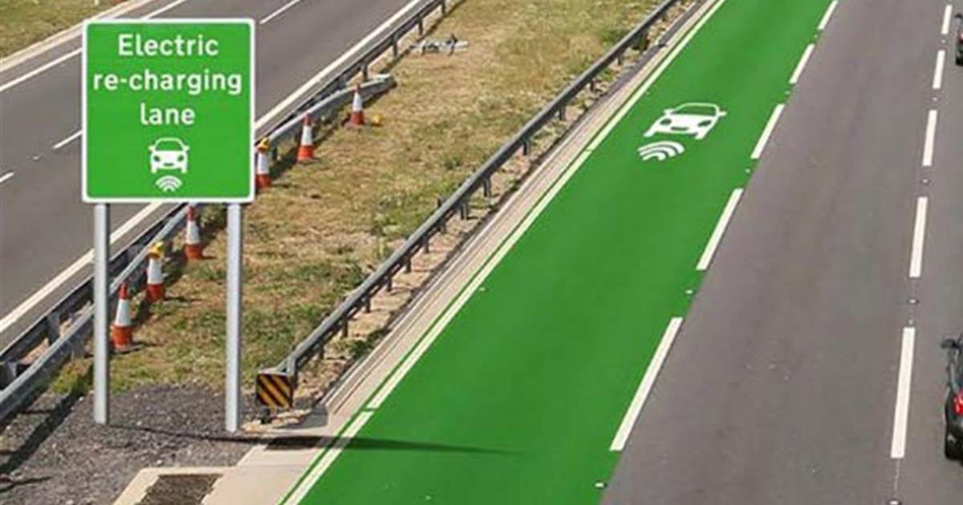
Electron’s Proposal Two
Proposal Two: Electric Car Rechargeable Roads Monitoring System.
Informs you which roads are currently clear for driving
Informs you which roads have the recharge facility working

Slide 5
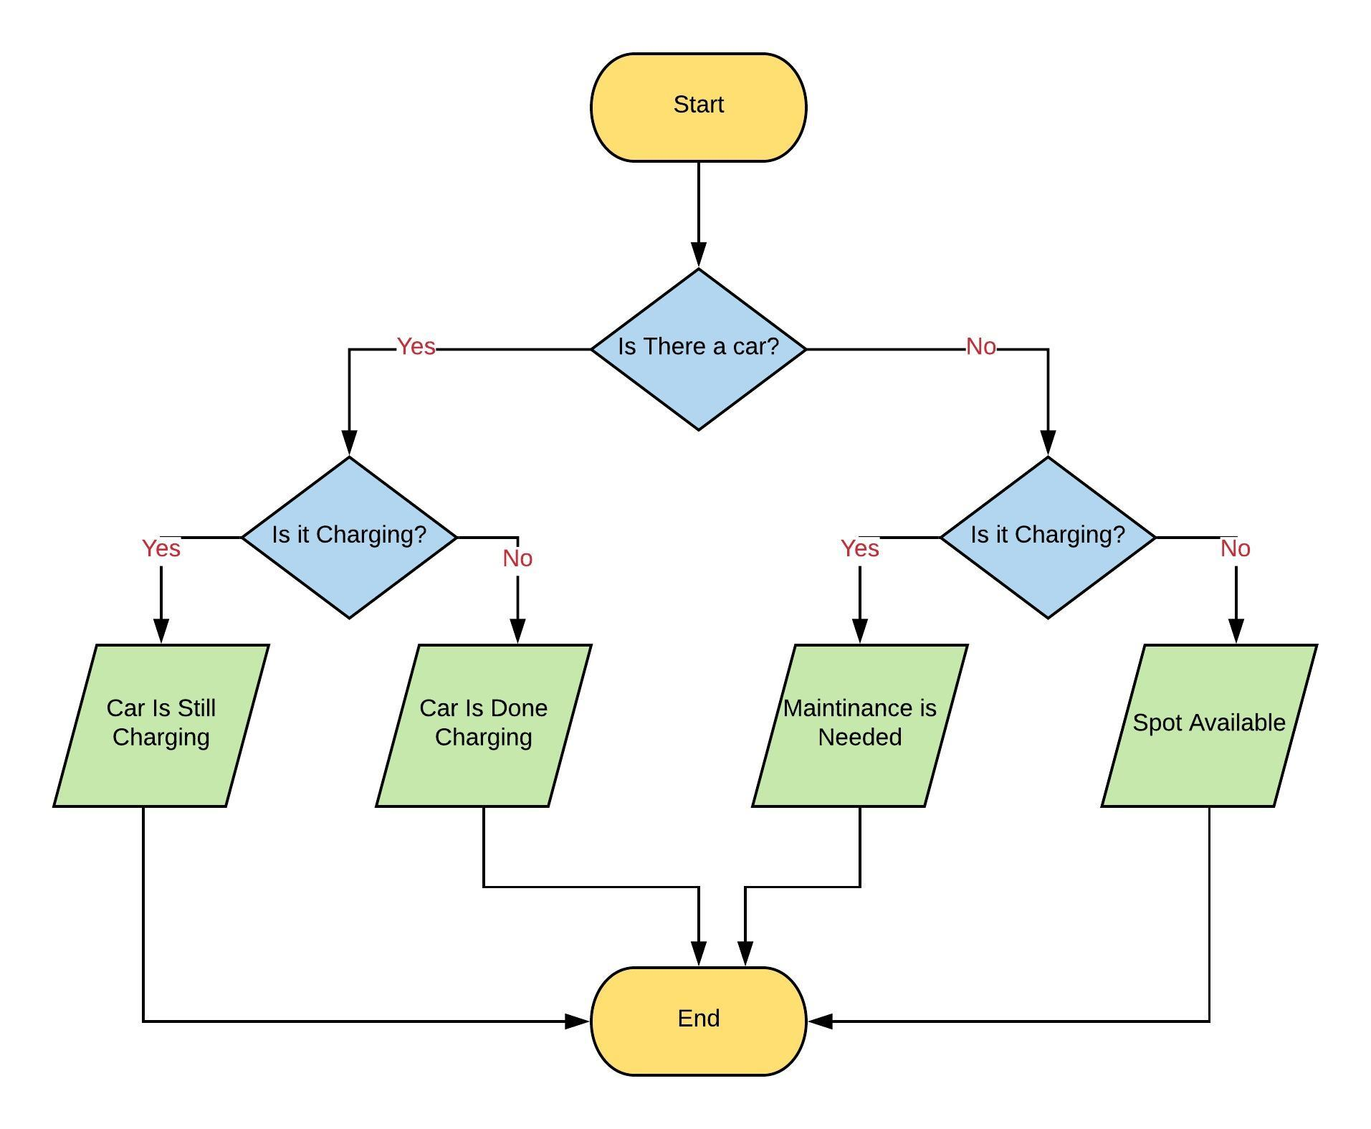
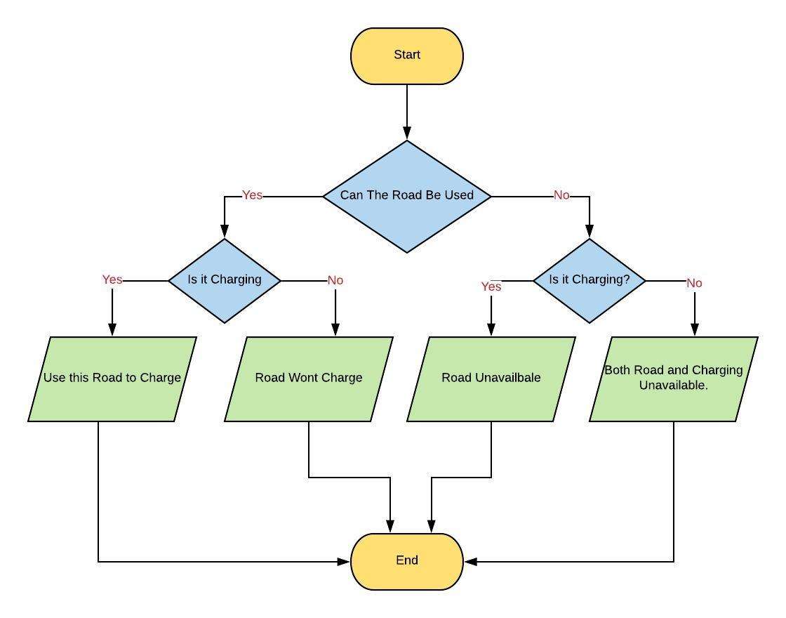
Flow Diagrams
Proposal 1
Proposal 2

Slide 6
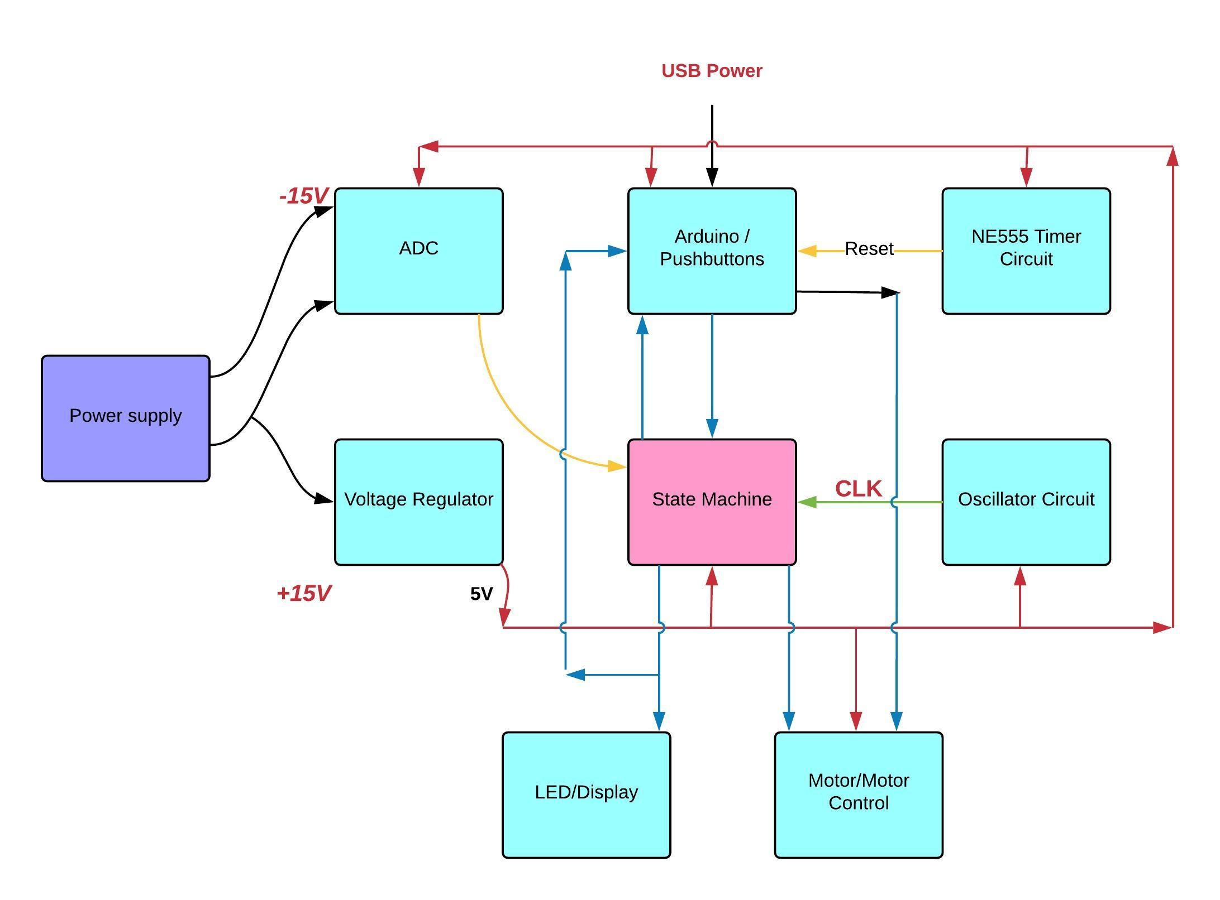
Block Diagram

Slide 7
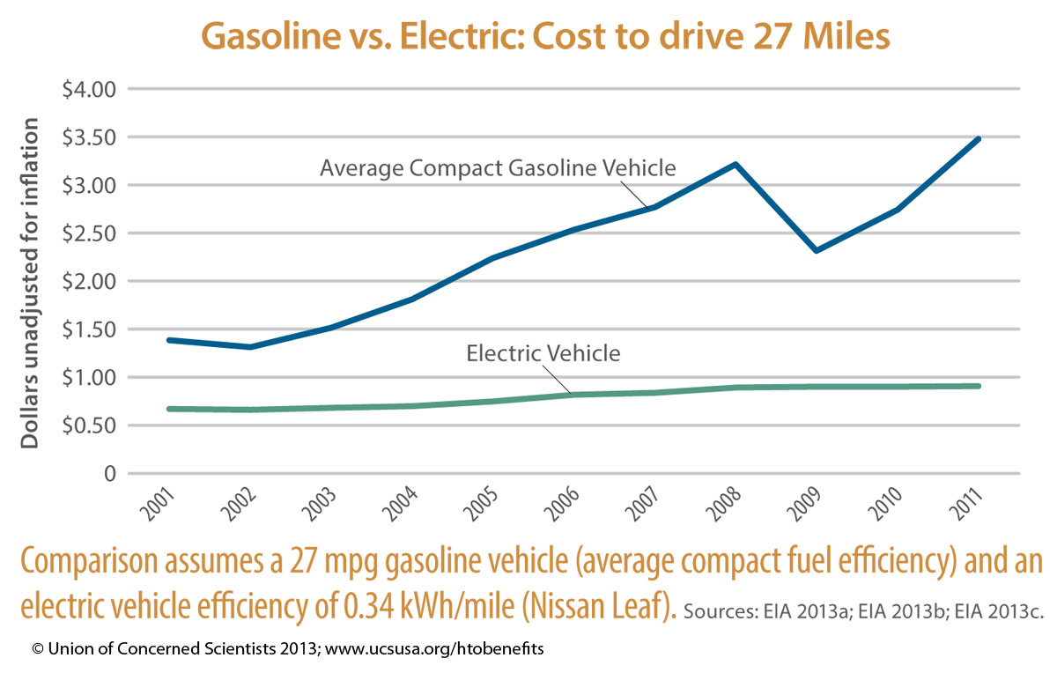
Why Electric Cars?
An electric car costs around 22000$.
Electricity is cheaper than gas.
Electric cars will be cheaper in the future with economies of scale.

Slide 8
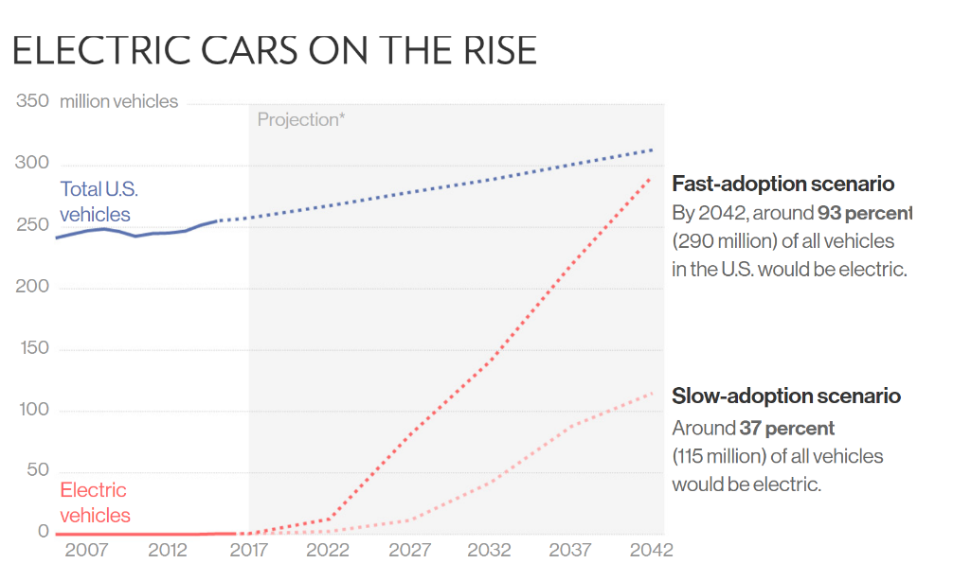
Prospective Market
The market share for Electric cars will increase highly by 2030.

Slide 9

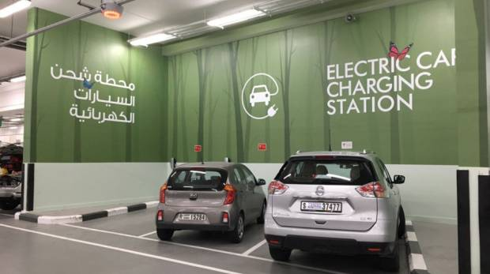
Prospective Market
“Dubai will spend millions of dirhams on incentives to have 42,000 electric vehicles (EVs) on the emirate’s streets by 2030 [1].”
About 220 free parking slots will be reserved for electric vehicles (EVs) across Dubai in 2018, The Roads and Transport Authority (RTA) confirmed [1].
The RTA has shown Significant interest in Sustainable and Electric Car related projects

Slide 10
What Benefits Do Our Proposals Offer!
Proposal 1:
Will notify the user if the parking spot is available or not.
Notifies the user if charging is complete.
Motor Controlled Gate to allow the user into the charging spots
Proposal 2:
Will notify the user about the availability of the road.
Will notify the user about the availability of the charging lane.
A servo motor will be used to operate traffic gates along the charge lane.

Slide 11
Labor Cost Estimation
 | Expected Time Spent (Hours) | Labor Cost (for 4 engineers per Deliverable)
Deliverable 1 | 6 | 1800 AED
Deliverable 2 | 12 | 3600 AED
Deliverable 3 | 5 | 1500 AED
Deliverable 4 | 8 | 2400 AED
Deliverable 5 | 18 | 5400 AED
Deliverable 6 | 30 | 9000 AED
Deliverable 7 | 4 | 1200 AED
Deliverable 8 | 3 | 900 AED
Total Labor Cost | 83 | 25,800 AED

Slide 12
Parts Cost Estimation
Components | Quantity | Price (per piece)
Push Buttons | 4 | In Arduino Kit (600 AED)
Potentiometer | 1 | In Arduino Kit (600 AED)
Red LED | 5 | In Arduino Kit (600 AED)
Green LED | 3 | In Arduino Kit (600 AED)
Servo Motor | 1 | In Arduino Kit (600 AED)
74HC74 (Dual D type f/f) | 3 | 2.2 AED
74HC132 (Quad 2-input NAND gate Schmitt Trigger) | 4 | 6 AED
74HC02(Q2-input NOR gate) | 2 | 2.2 AED
NE555 Timers | 1 | 3 AED
74LS08 (Q2-input AND gate) | 3 | 2.5 AED
74LS04 (HEX Inverter) | 3 | 2.3 AED
74HC86 (Quad 2-input XOR) | 1 | 2.5 AED
 | Total Cost | 700 AED (Including possible Variation 30 AED)

Slide 13

The Future Brought To the Present Electron
Electric Cars and sustainable systems are the future.
Electron systems will benefit the overall Eco-system and work hand in hand with society for a better tomorrow.

Slide 14

Why Electron?

Slide 15


Slide 16
References
https://www.thenational.ae/business/energy/dubai-announces-new-electric-vehicle-incentives-1.661286
https://www.payscale.com/research/AE/Job=Cost_Engineer/Salary
http://www.arabianbusiness.com/interviews/transport/377757-how-the-uae-is-revving-up-for-an-electric-car-revolution
https://www.vox.com/2016/6/6/11867894/electric-cars-global-sales

Slide 17
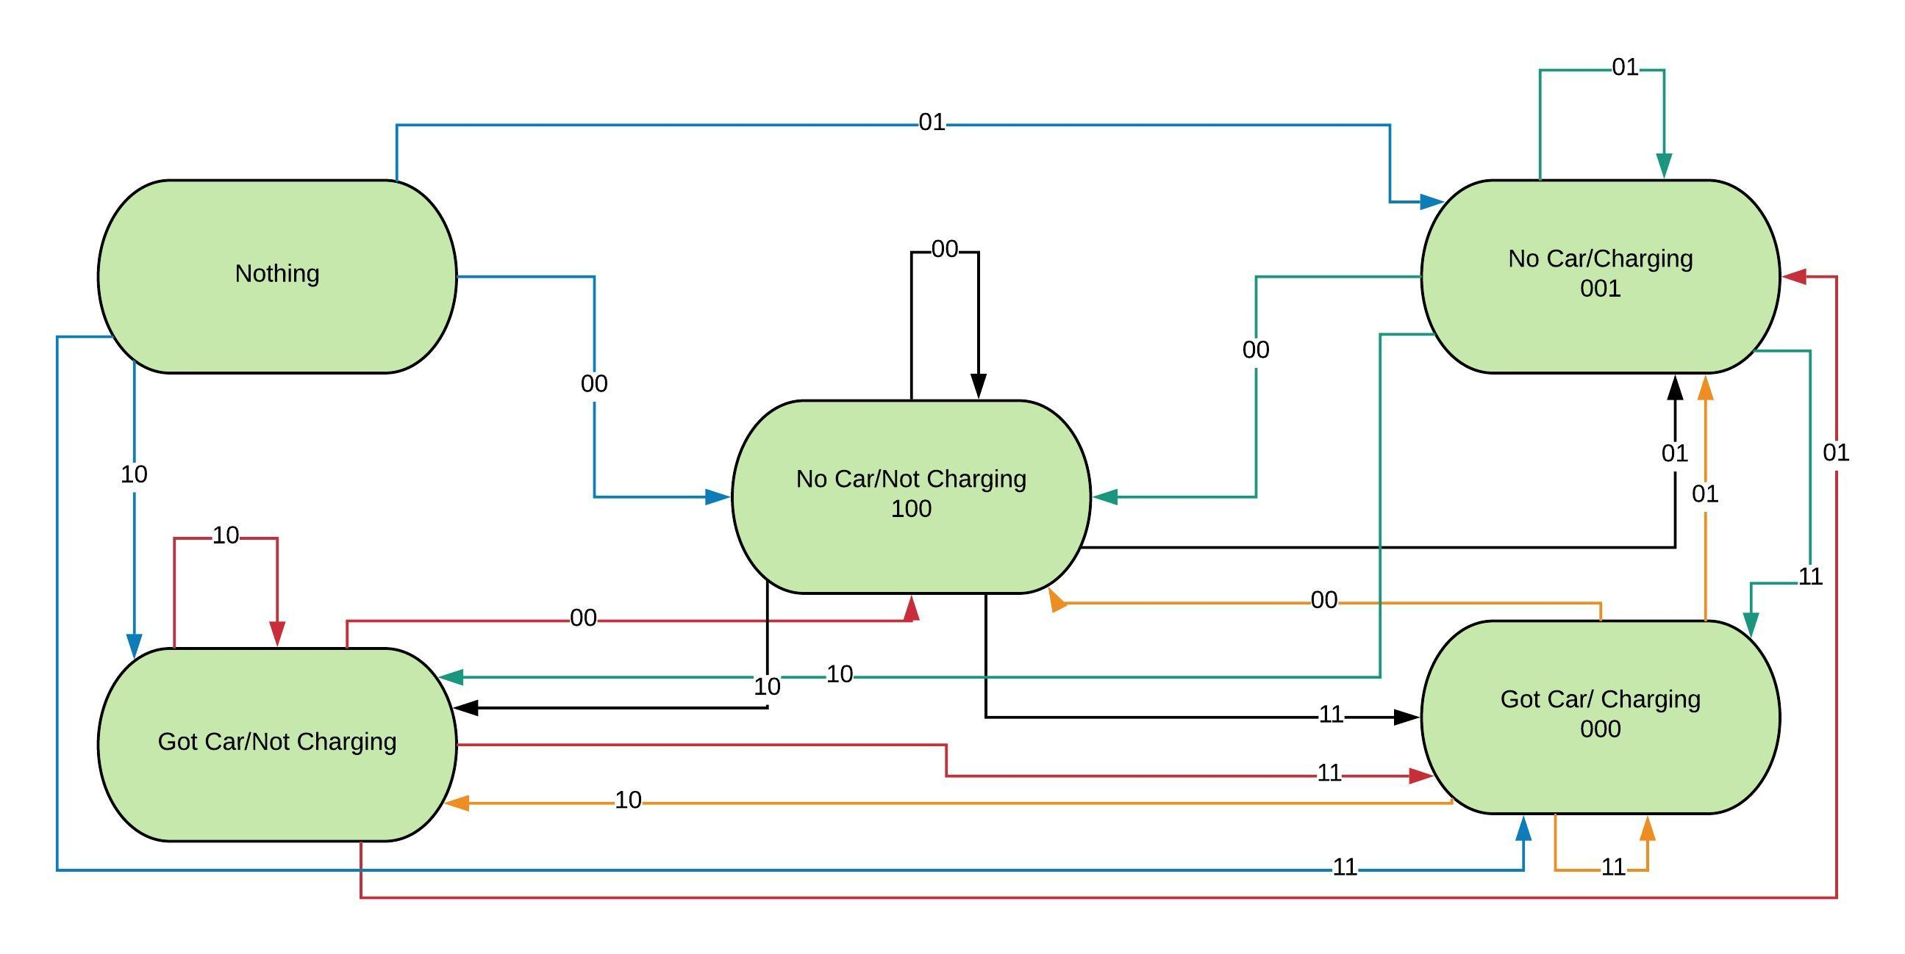
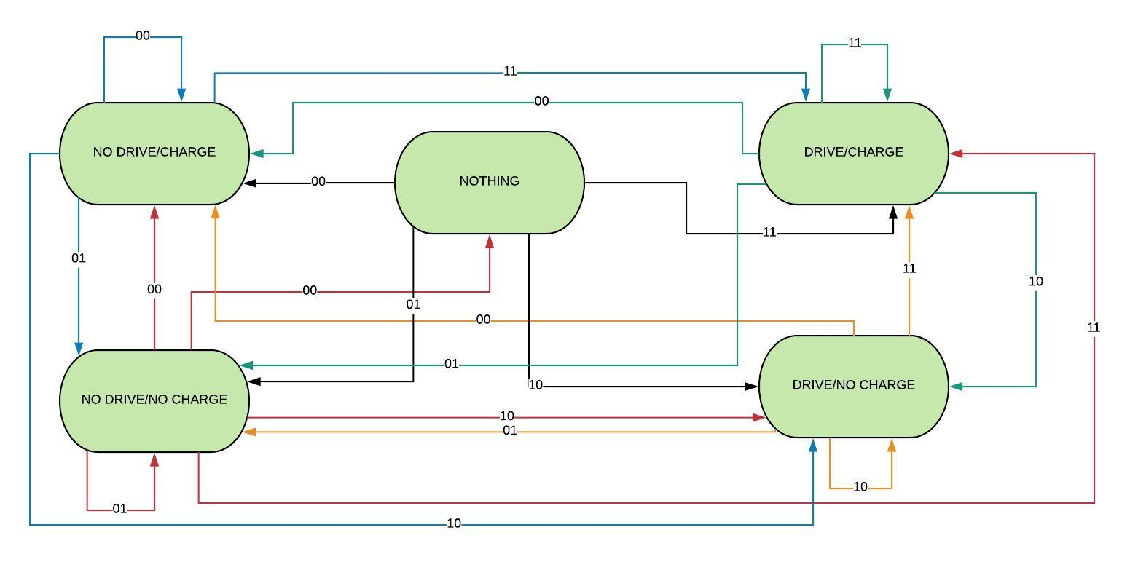
State Diagrams
Proposal 1
Proposal 2

Slide 18
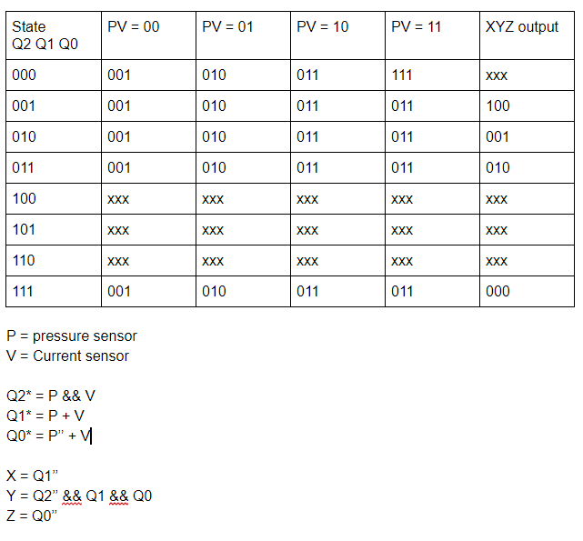
State Table And Boolean Expressions for proposal one
Inputs:
P – Pressure Sensor
- 0 = No car
- 1 = Car present
V – Current switch
- 0 = Not charging
- 1 = Charging
Outputs:
X – One if Spot Available
Y – One if Car Done Charging
Z – One if Fault Detected

Slide 19
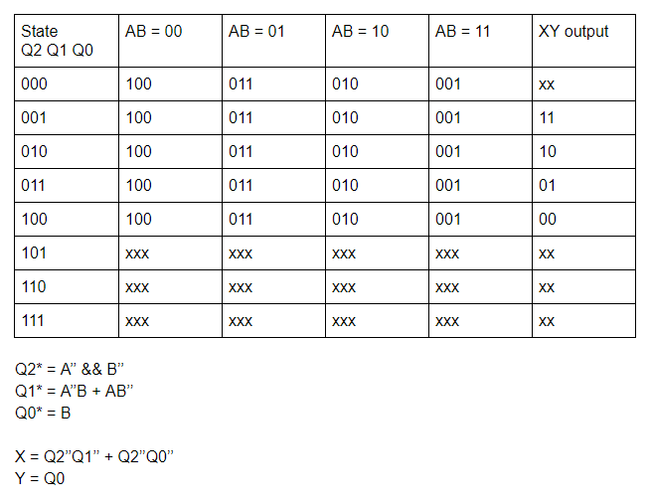
State Table And Boolean Expressions for proposal one
Inputs:
A – Motor operated gate
- 0 = Closed
- 1 = Open
B – Current switch
- 0 = Charging not available
- 1 = Charging is available
Outputs:
X – One if the road is available
Y – One if Charging system is operational

Slide 20
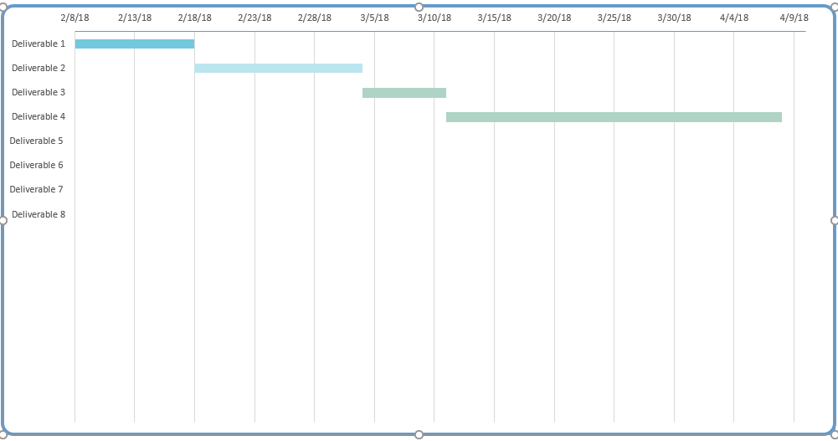
Gantt Chart
Deliverable One: Proposal Presentation
Deliverable Two: Detailed Design
Deliverable Three: Design Simulation
Deliverable Four: Breadboard Prototype
Deliverable 5: Perfoboard
Deliverable 6: Final Design Report
Deliverable 7: Final Design Presentation
Deliverable 8: Trade Show

